Slide 1
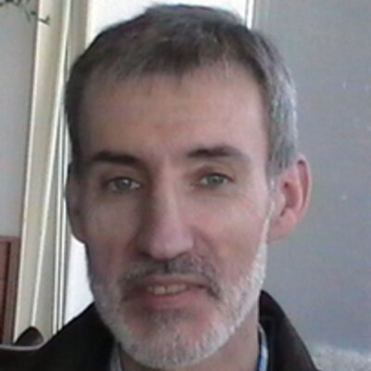
Joserra Zalakain
Teacher of English as FL and a Moodler
Notes:
My introduction

